Slide 1
COMP90018 Mobile Computing Systems Programming
Prof. Vassilis Kostakos

Slide 2
Introduction to LBS
Location-based services (LBS)
Services that integrate a mobile’s device location with other information
Available at least since the 1970s (GPS: US military)
Mobile operators
Voice, data (SMS, MMS, Video), location information
Push versus pull
User receives information without an active request
User actively pulls information from the network

Slide 3
Applications I
Infotainment services
Driving directions
Where is a point of interest (POI): ATM, hotel, restaurant, …
Where am I? Location on a map
Where are my friends?
Tracking services
Fleet management, taxi monitoring and dispatching
Children, elderly people, sick persons
Goods and package tracking

Slide 4
Applications II
Information dissemination services
Content delivery wrt. the user’s context & profile
Advertisement & e-coupons
Hazard warnings
Emergency support systems
Police, ambulance, fire brigades
Roadside assistance
Location-sensitive billing
Call billing based on vicinity from base/home
Toll payment

Slide 5
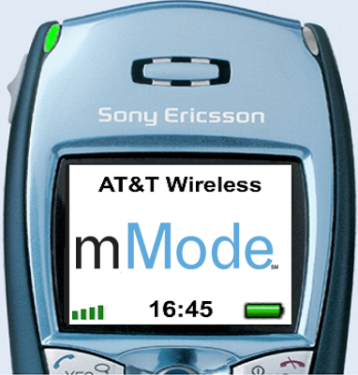
AT&Ts Find Friend
User interface
User can add friends to a list
Send a SMS with a tracking request
Privacy
“Invisible” mode allows to hide from all users
Tracking requests always generated an alert
Services
Driving directions or meeting point between friends
Search for all friends

Slide 6
Location-based Services
1st Generation
Manual user input of location information
Driving directions, nearby POIs, weather information
2nd Generation
Location information is acquired automatically within a couple of kilometers
Similar services as in 1st generation
3rd Generation
High position accuracy & automatic initiation of services
Asset tracking, street-level routing and positioning, …

Slide 7
Localisation technologies
Location enables a variety of ubicomp applications providing services appropriation to specific location and context
Routing phone calls to phone closest to user’s current location (Want et al. 1992)
Sending printouts to nearest printer, displaying files specific to user’s location (Schilit et al. 1999)
Location is one of the most important components of user context
Allows also infering additional pieces of context (user activity, mode of transportation, social relationships)
No single location technology is accurate, low-cost, easy to deploy and ubiquitous
Typically tradeoff between accuracy, coverage and cost

Slide 8
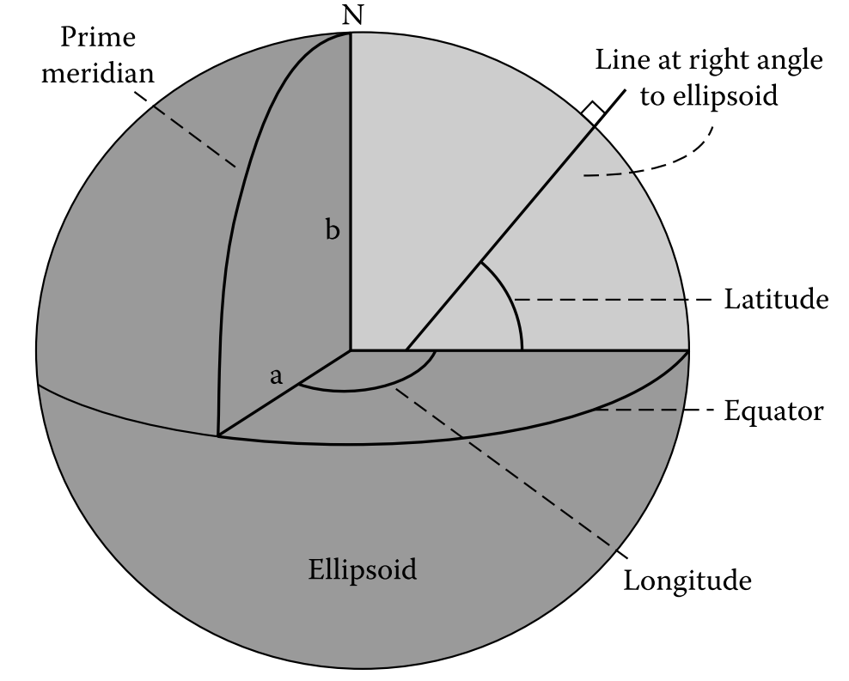
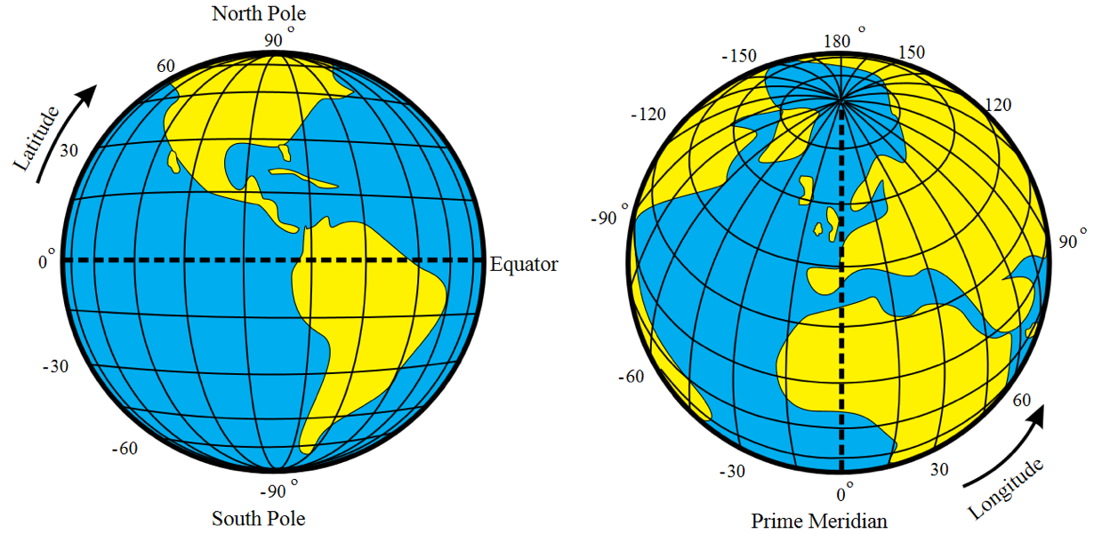
Location representation
Location can be represented in absolute, relative or symbolic form
Absolute: exact position such as address or GPS coordinates
Relative: St Kilda is 3 km south of Melbourne
Symbolic: home, work, bedroom, beach, etc.
Geographic coordinates: latitude and longitude
University of Melbourne:
37°47'49.1"S, 144°57'44.5"E

Slide 9
Infrastructure and client-based location systems
Client-based location system
Device computes its own location
Example: GPS
Main advantage: preserves location privacy of the device
Network-based location system
Network infrastructure calculates position of device
Network-assisted location system
Both device and network infrastructure participate in computing location
Example: A-GPS

Slide 10
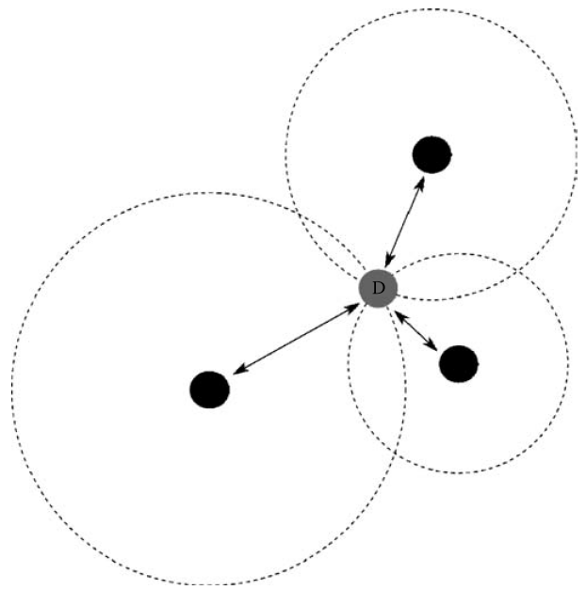
Approaches to determining location (1)
Proximity
Location is estimated from closeness of device to reference point
Example: proximity to a wireless AP
Trilateration
Position of device is computed from distances between device and reference points at known locations
Number of reference points = number of physical space dimensions + 1
Time of flight
Requires clock synchronization between reference points
Signal strength attenuation
Signal attenuation model
Subject to complex interactions with physical environment

Slide 11
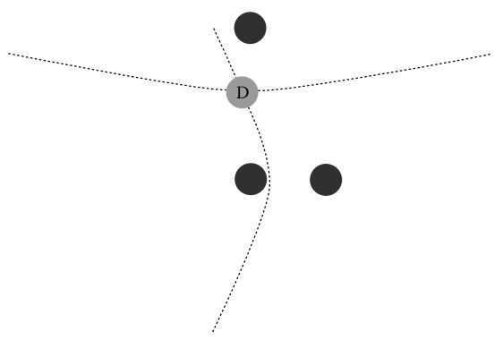
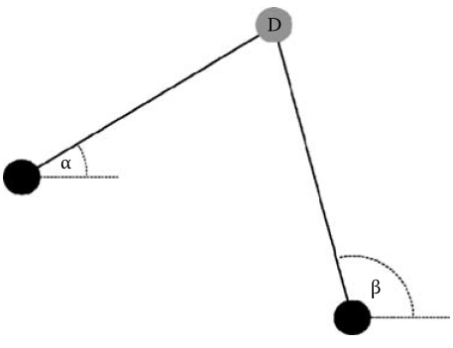
Approaches to determining location (2)
Hyperbolic lateration
Difference between signal arrival times (TDOA) at two reference points defines location of device as hyperbolic line
Triangulation
Location is estimated from angle of arrival (AOA) of signals between device and reference points
Estimation of AOA requires directional antenna or antenna array, thus AOA is typically measured at reference points (not at device)

Slide 12
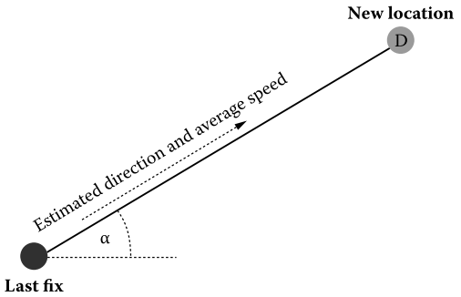
Approaches to determining location (3)
Fingerprinting
RF fingerprinting relies on two properties of radio signals: temporal stability and spatial variability
In training phase RF measurements (”fingerprint”) are captured from target environment (spatial resolution vs positioning accuracy)
Location estimate is obtained by comparing current RF measurement to training measurement
Measurements by device, location computations by device or infrastructure
Dead reckoning
Location is computed from previously known location (fix), elapsed time, direction and average speed of movement

Slide 13
Error reporting
Sources of errors
Incorrect reference point coordinates
Ionospheric and tropospheric delay
Clock synchronization
Multipath propagation
Geometry
Reporting error
Symbolic locations: confidence intervals (correct 85% of the time)
Absolute locations: cumulative distribution function of location error

Slide 14
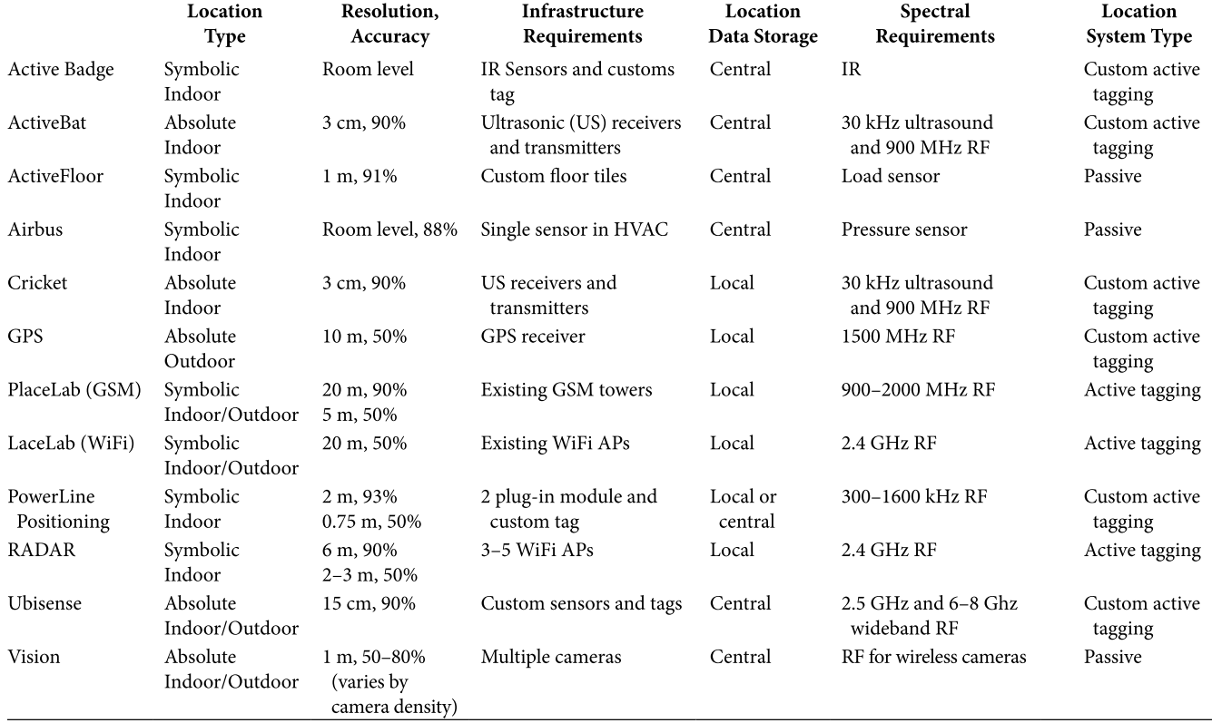
Location systems (some obsolete)

Slide 15
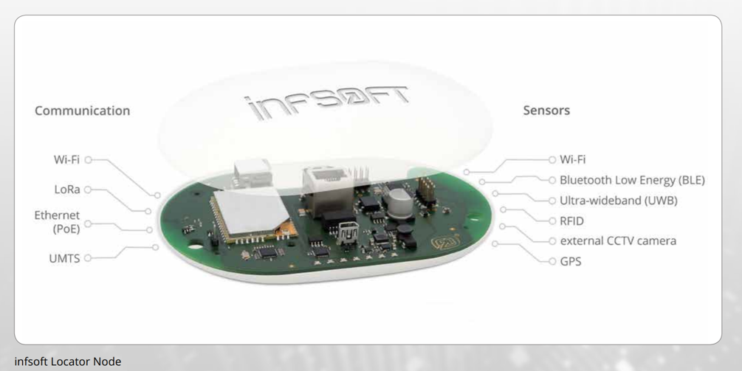
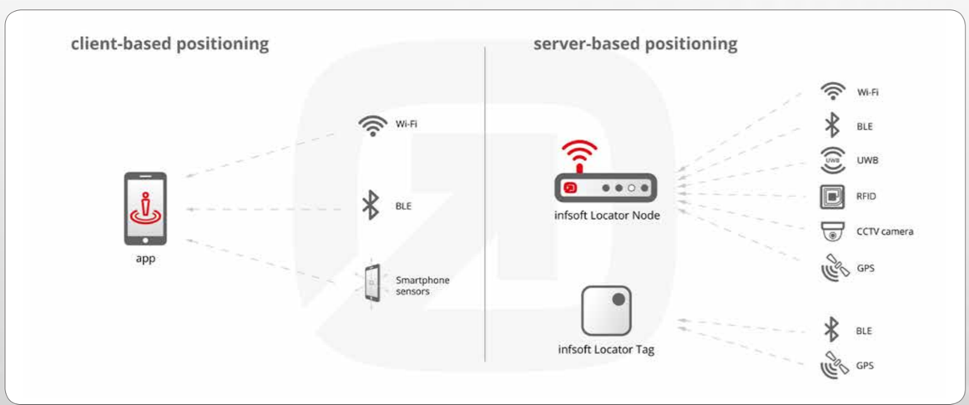
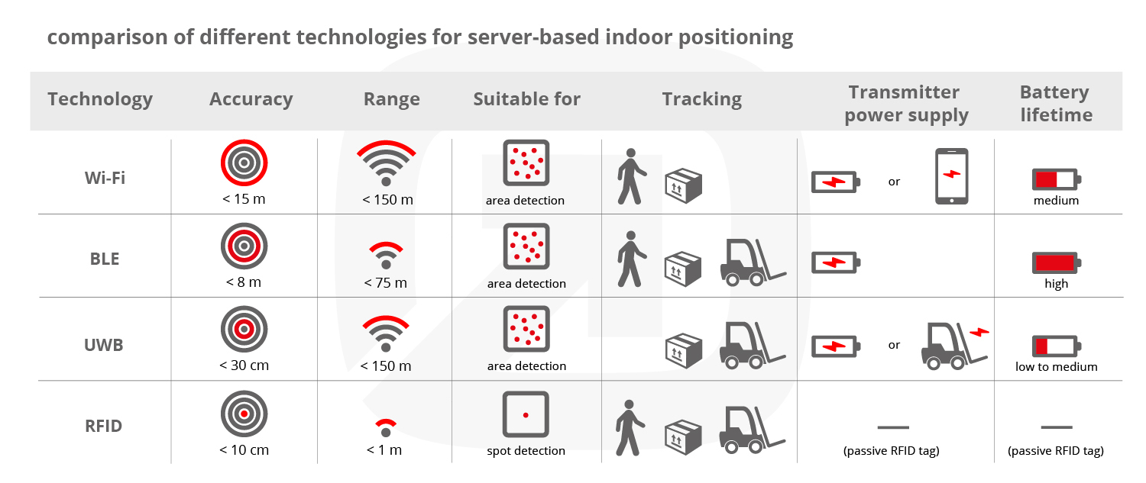
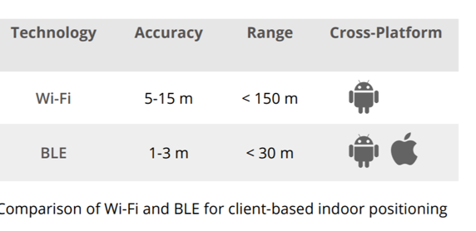
Example modern positioning system: Infsoft

Slide 16
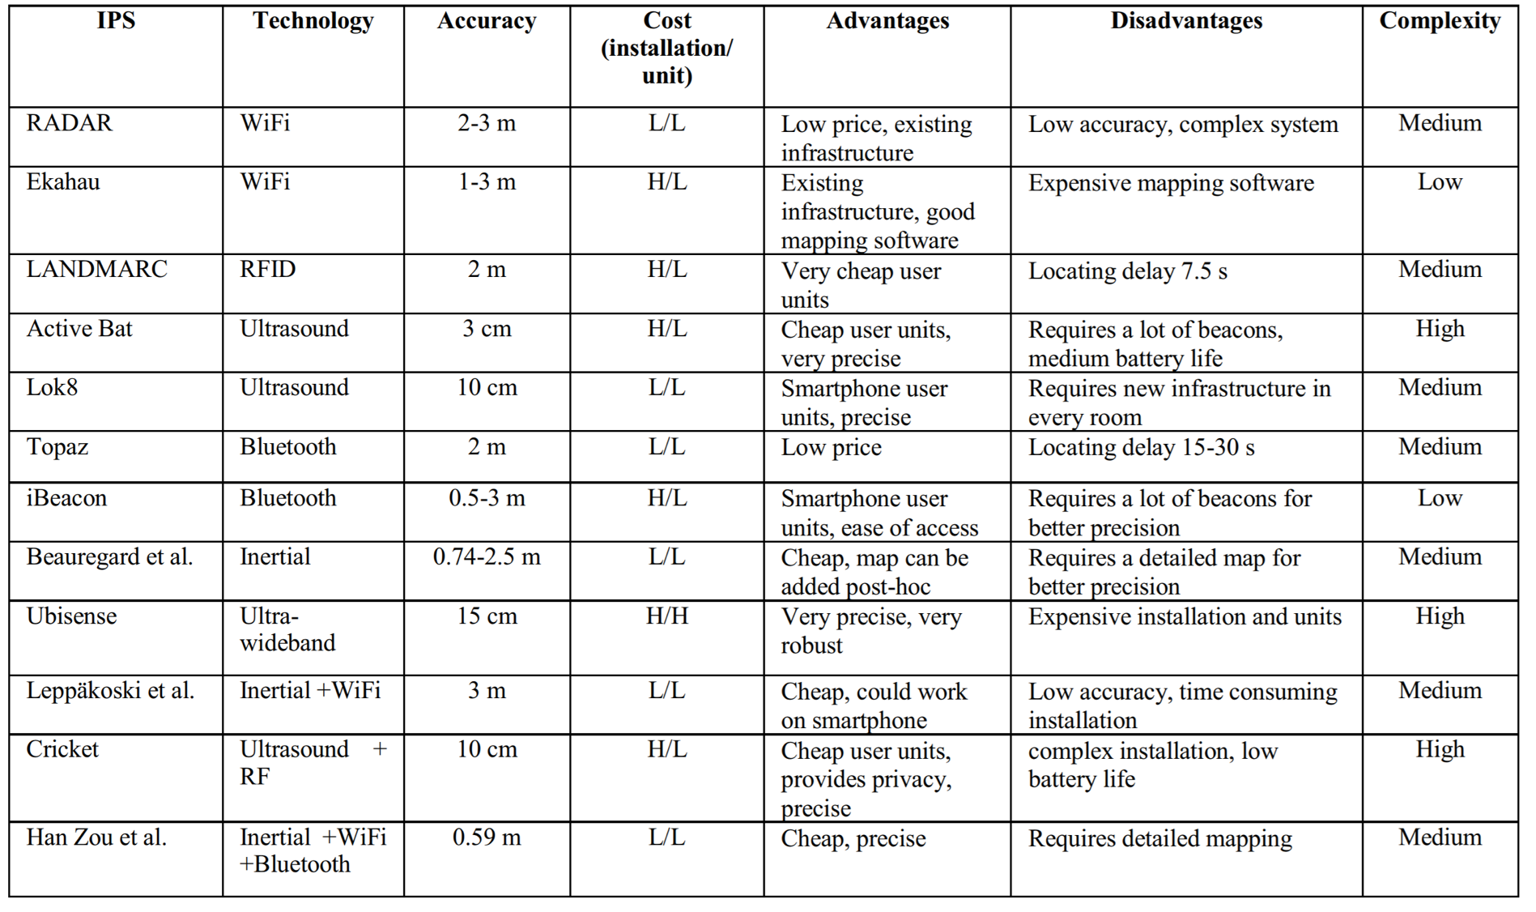
Comparison of indoor positioning systems (Batistic & Tomic, 2018)

Slide 17
Smart floor

Slide 18
In-home localisation

Slide 19
Sensing via air pressure

Slide 20

Break! – 15 minutes
During the break, please complete the questionnaire at:
http://go.unimelb.edu.au/jb8r

Slide 21
Selected examples of research on location-aware systems

Slide 22
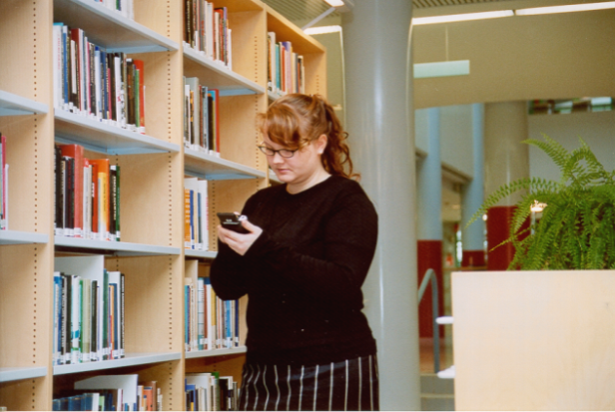
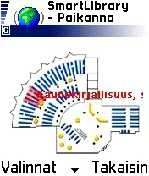
SmartLibrary (2003)
One of the first examples
Adaptation of existing service for various mobile devices
Automatic UI adaptation based on HTTP user agent
Optional map-based guidance
WLAN positioning of the device based on RF fingerprint
Motivation
To provide mobile access to library database
To assist library users in finding books by themselves
Users not familiar with the shelf classification system overload the library staff with their requests for guidance

Slide 23
SmartLibrary version 1
Separate client application for WLAN positioning of the PDA
"Raw" graphics
In user evaluation map-based guidance to books proved useful, especially to novice library patrons
Usefulness of dynamic relative user positioning remained doubtful
Aittola M, Ryhänen T & Ojala T (2003) SmartLibrary - Location-aware mobile library service. Proc. Mobile HCI 2003, Udine, Italy, 411-416.

Slide 24
SmartLibrary version 2
Pure web-based (XHTML) browsing UI
Web CPI (Content Provider Interface) for content management
Other library resources included, in addition to books
Improved graphics
Had to create floorplans for the whole university :)
Aittola M, Parhi P, Vieruaho M & Ojala T (2004) Comparison of mobile and fixed use of SmartLibrary. Proc. Mobile HCI 2004, Glasgow, Scotland, 383-387.

Slide 25
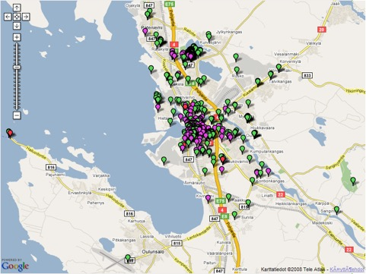
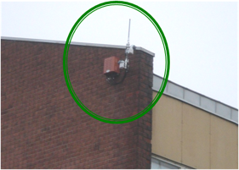
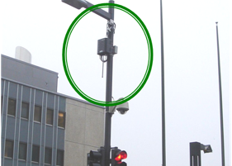
panOulu WiFi
November 13, 2014
Slide

Slide 26
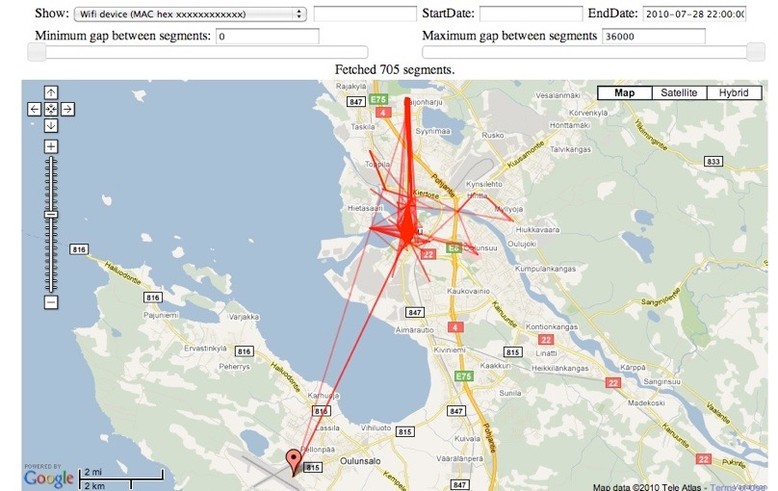
Reconstructing movement
November 13, 2014
Slide

Slide 27
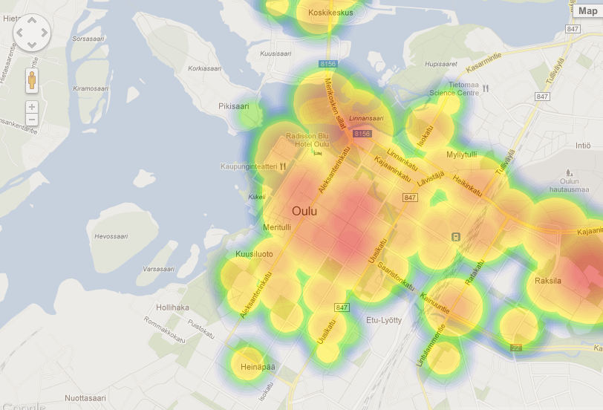
Where is it busy now?

Slide 28
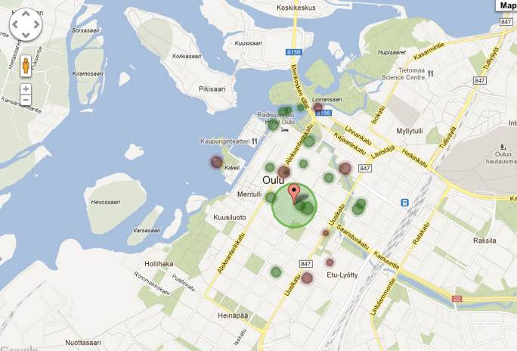
Catchment areas

Slide 29
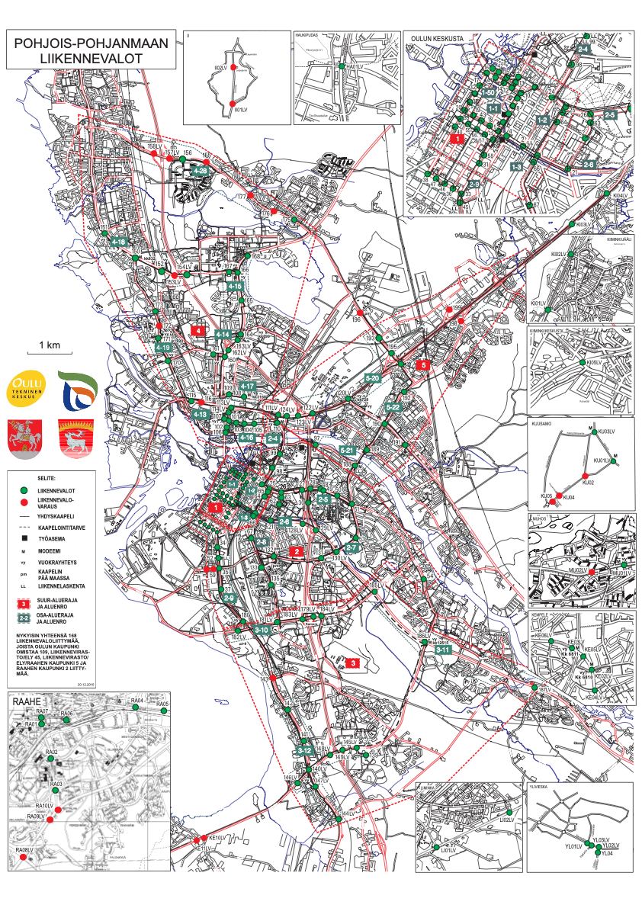
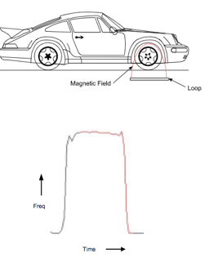
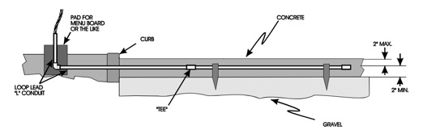
Induction loops

Slide 30
Smarter traffic lights

Slide 31

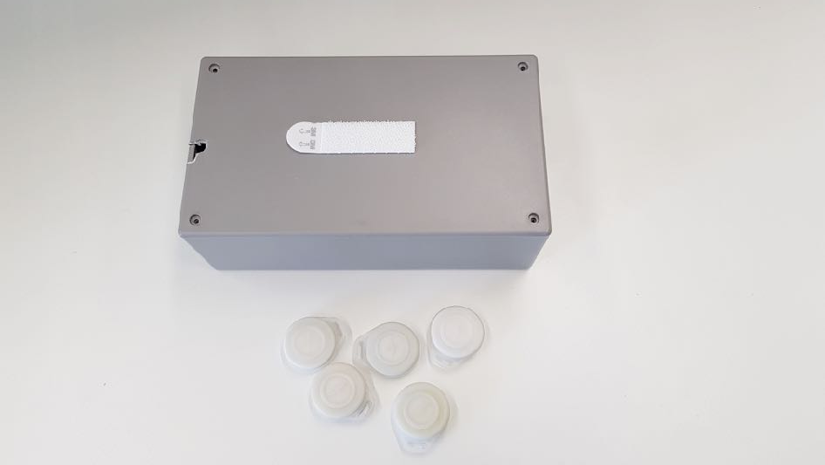
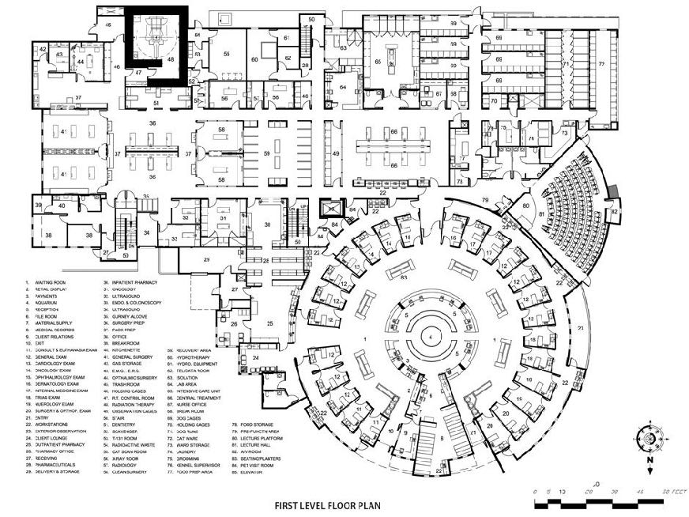
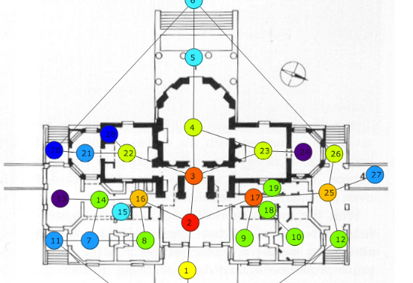
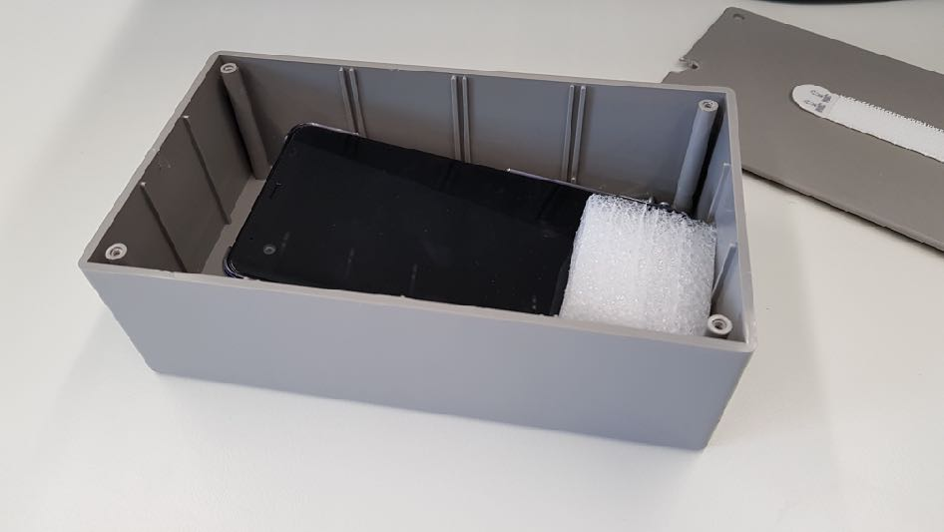

Operating theatre tracking
Track patients/staff in & out of operating theatres

Slide 32
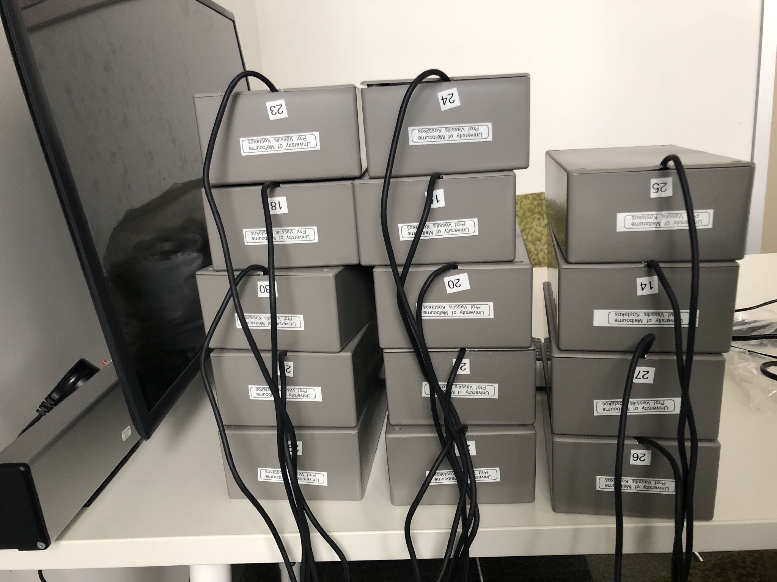

Slide 33
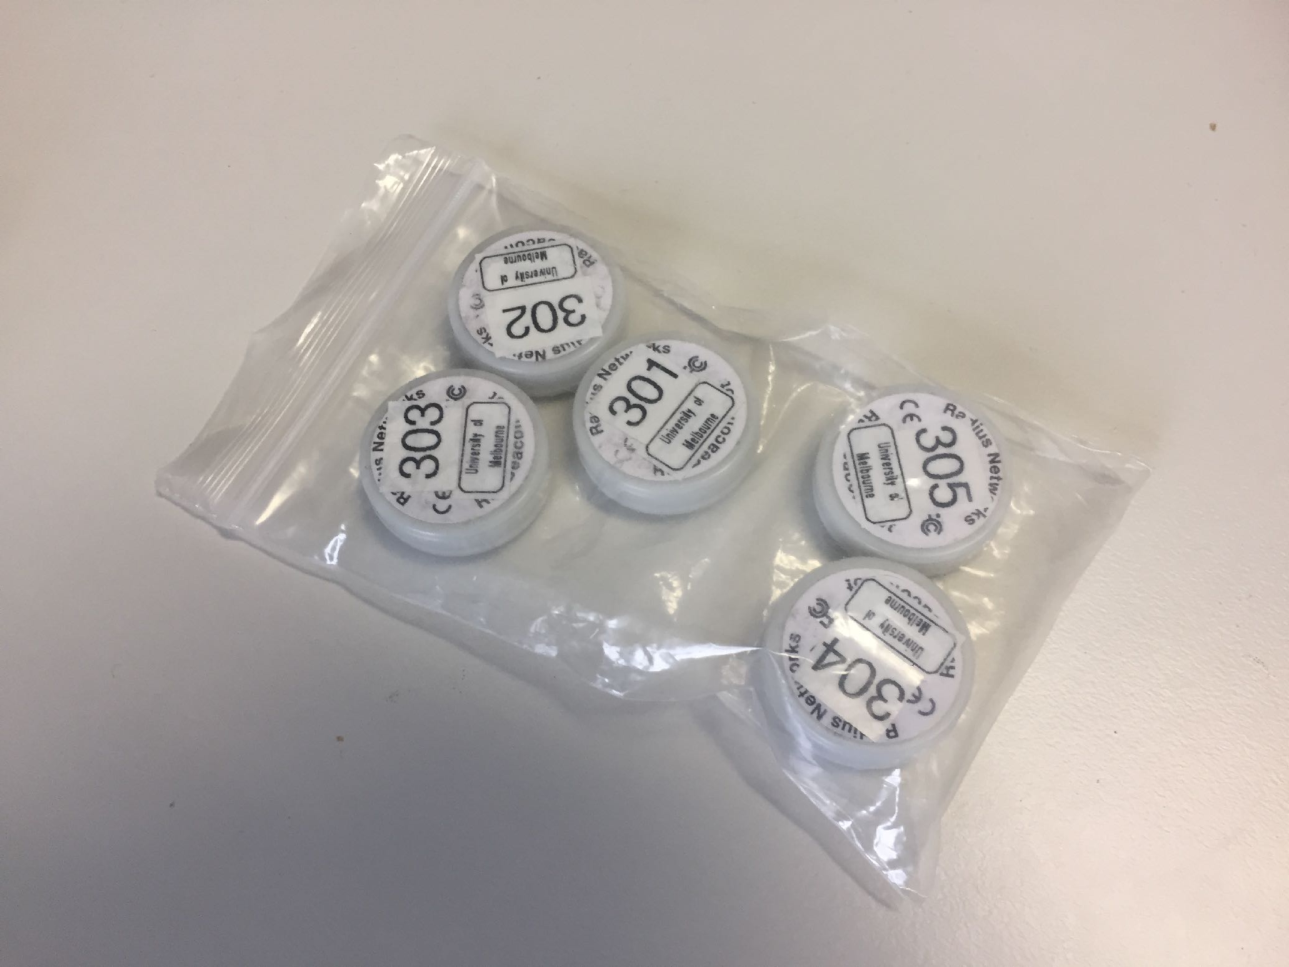

Slide 34
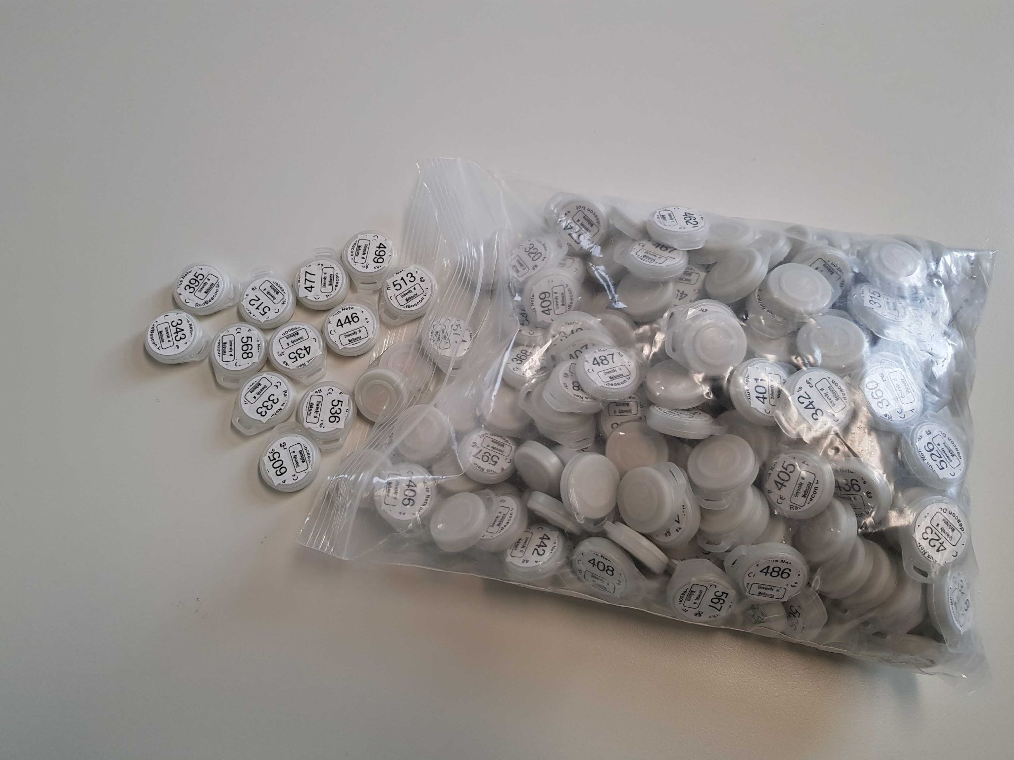

Slide 35
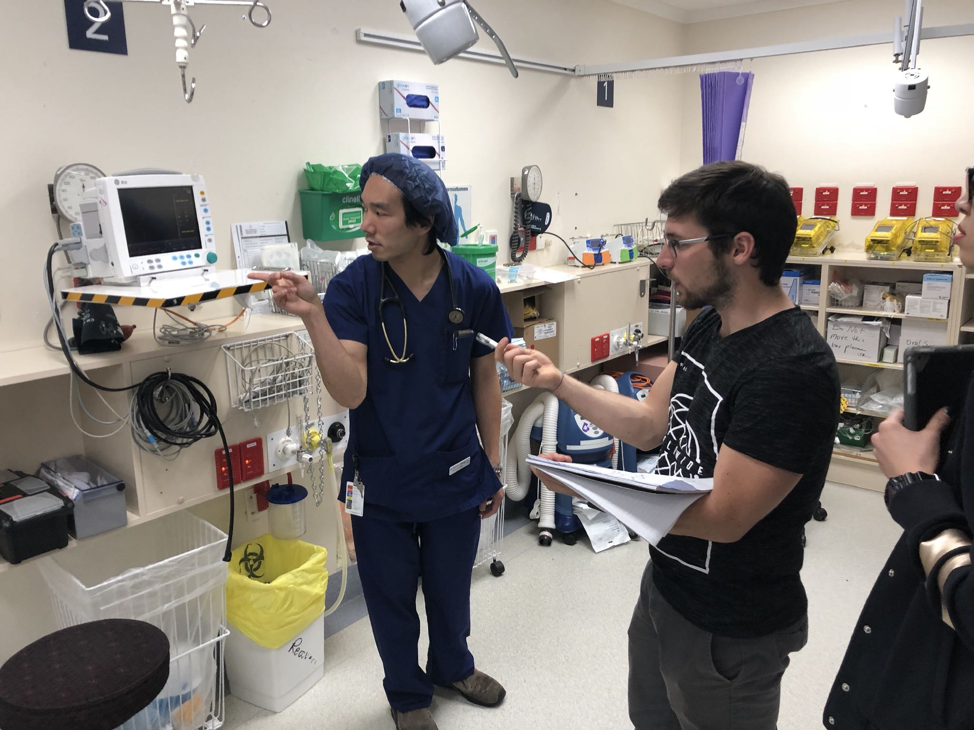


Slide 36


Slide 37


Slide 38
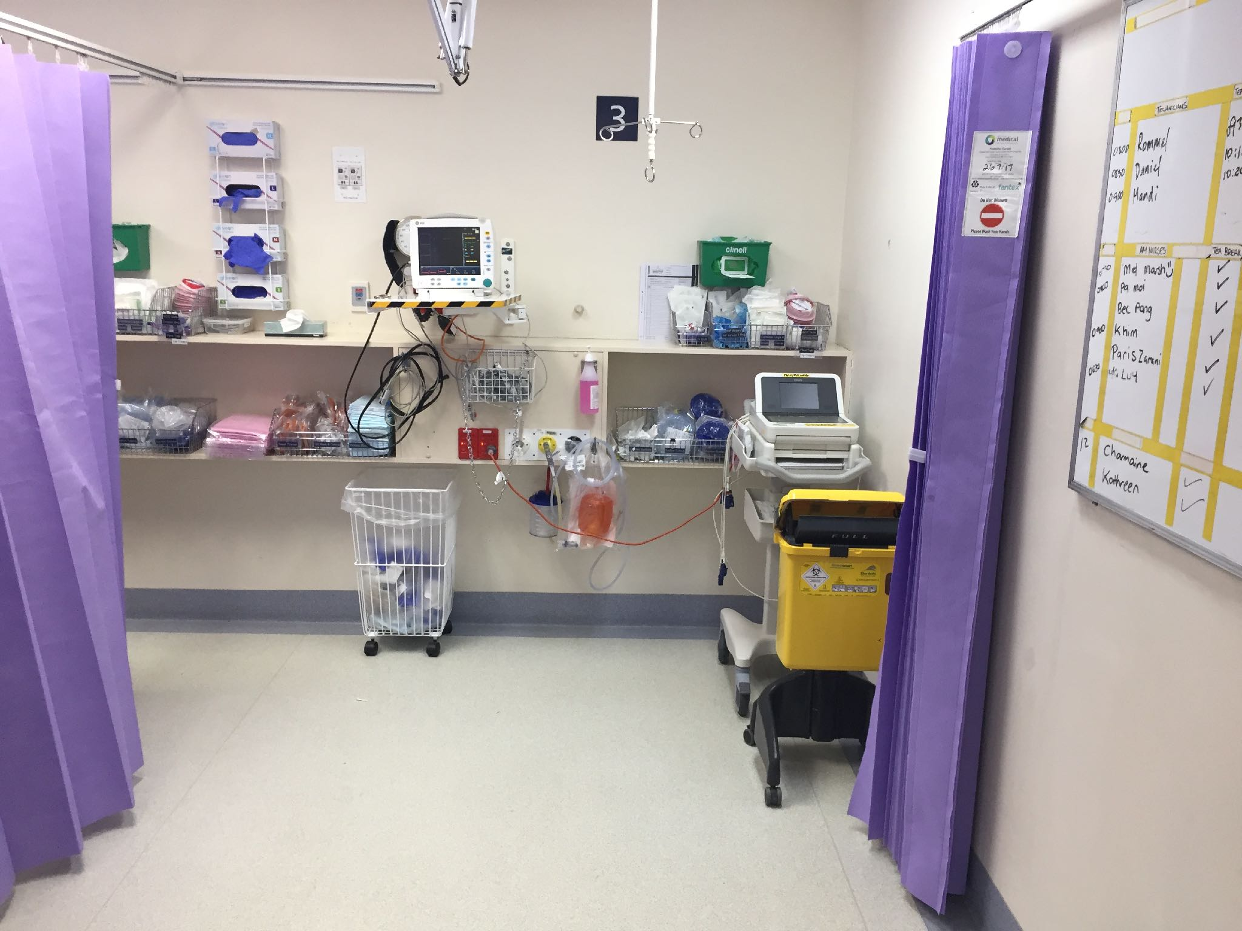

Slide 39
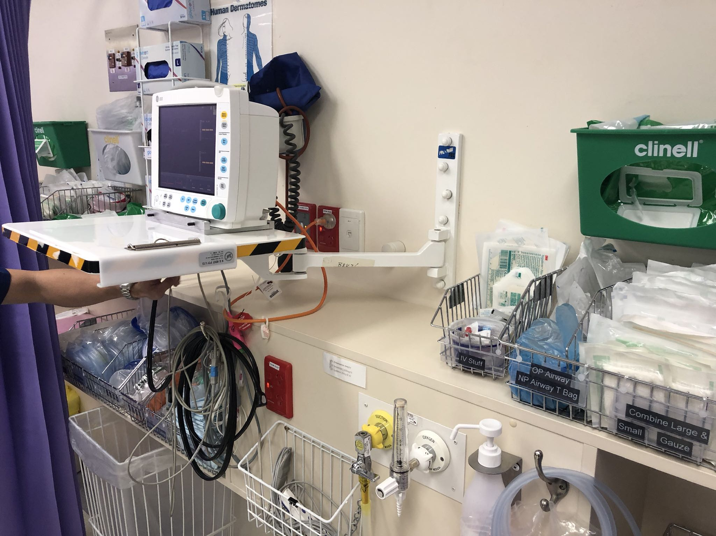

Slide 40
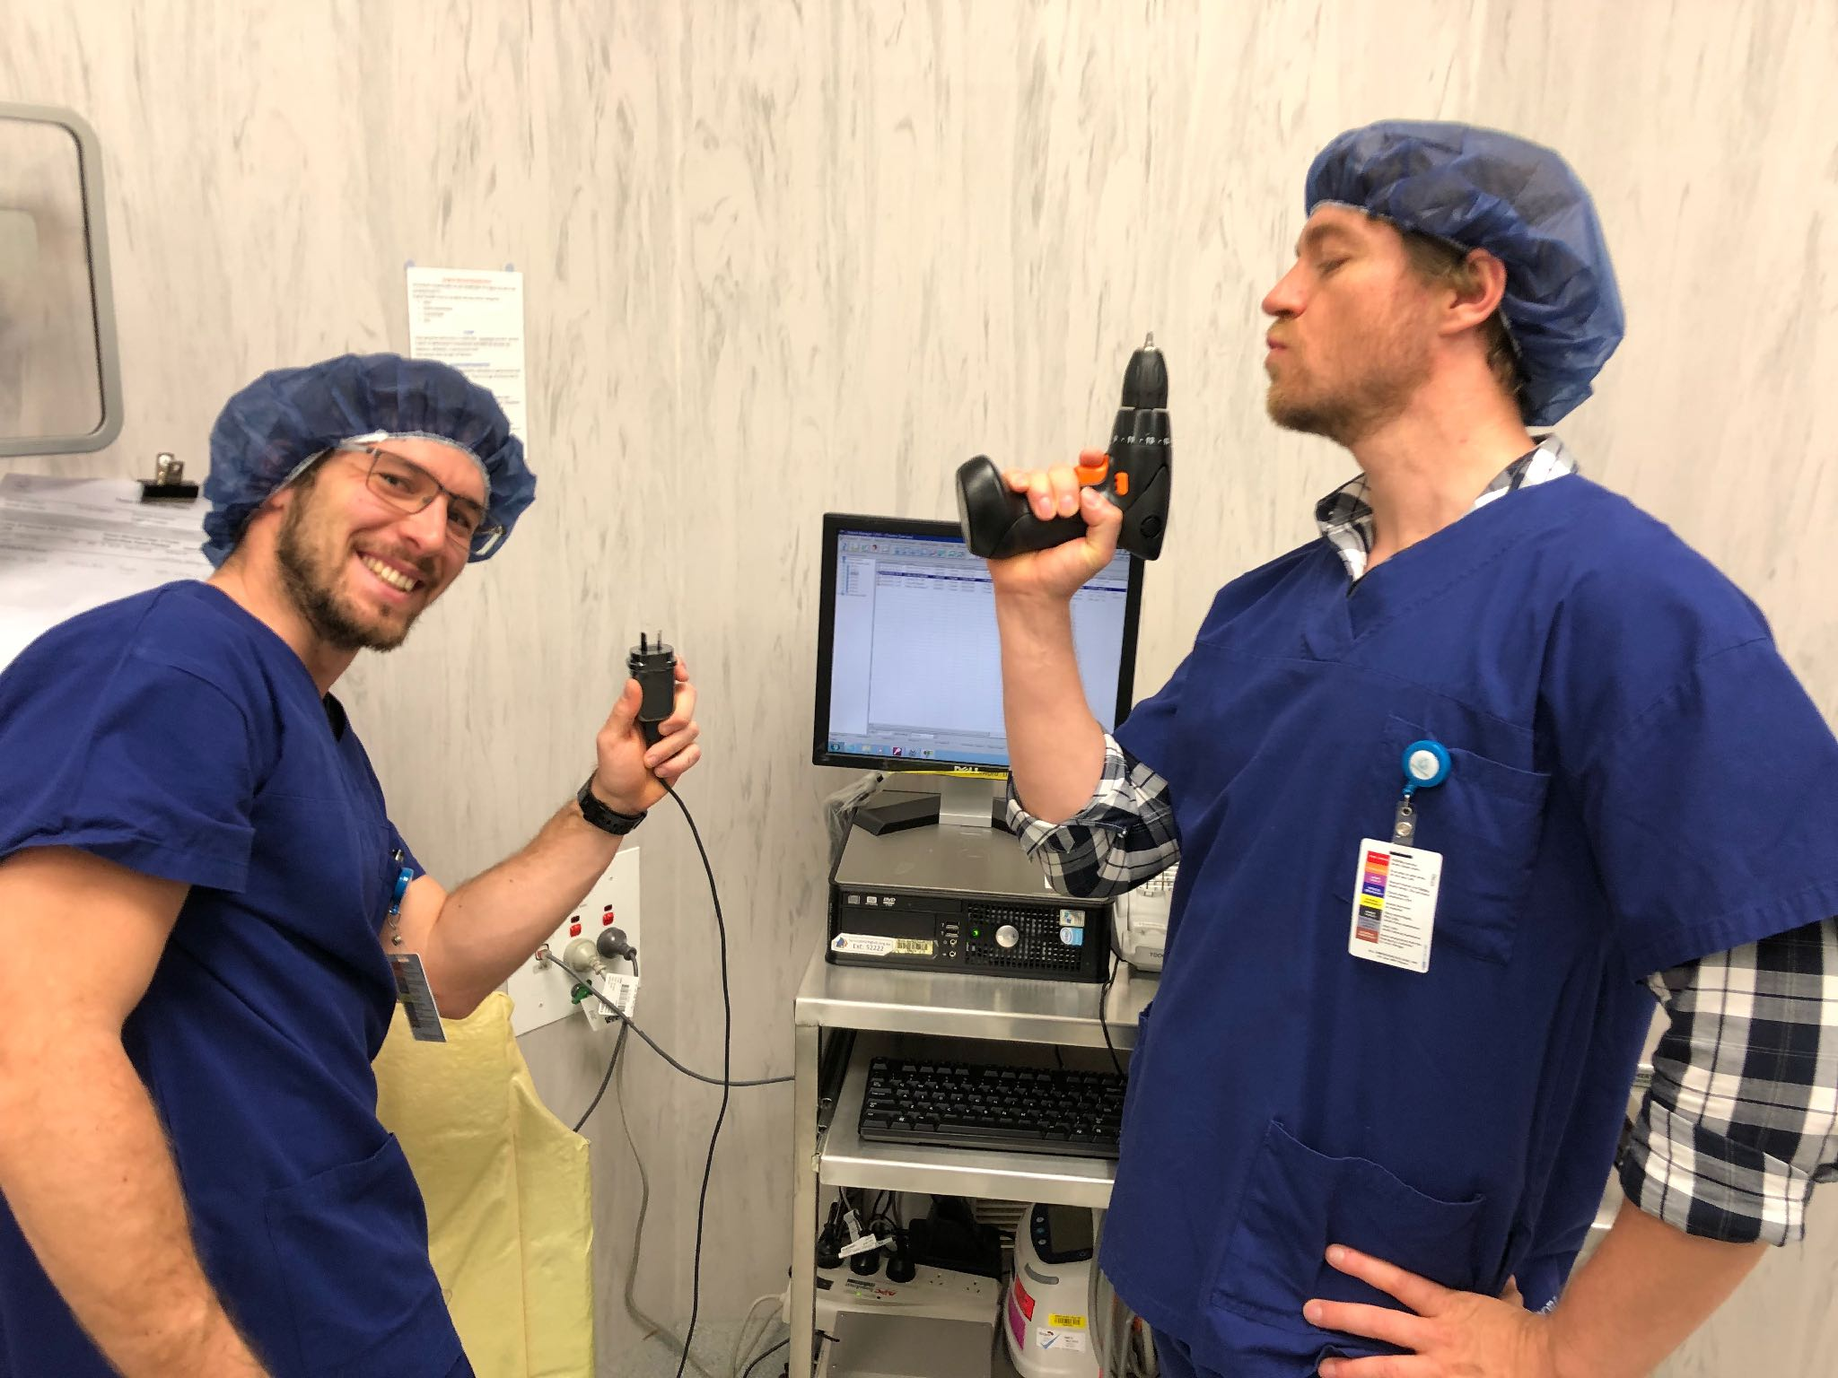

Slide 41
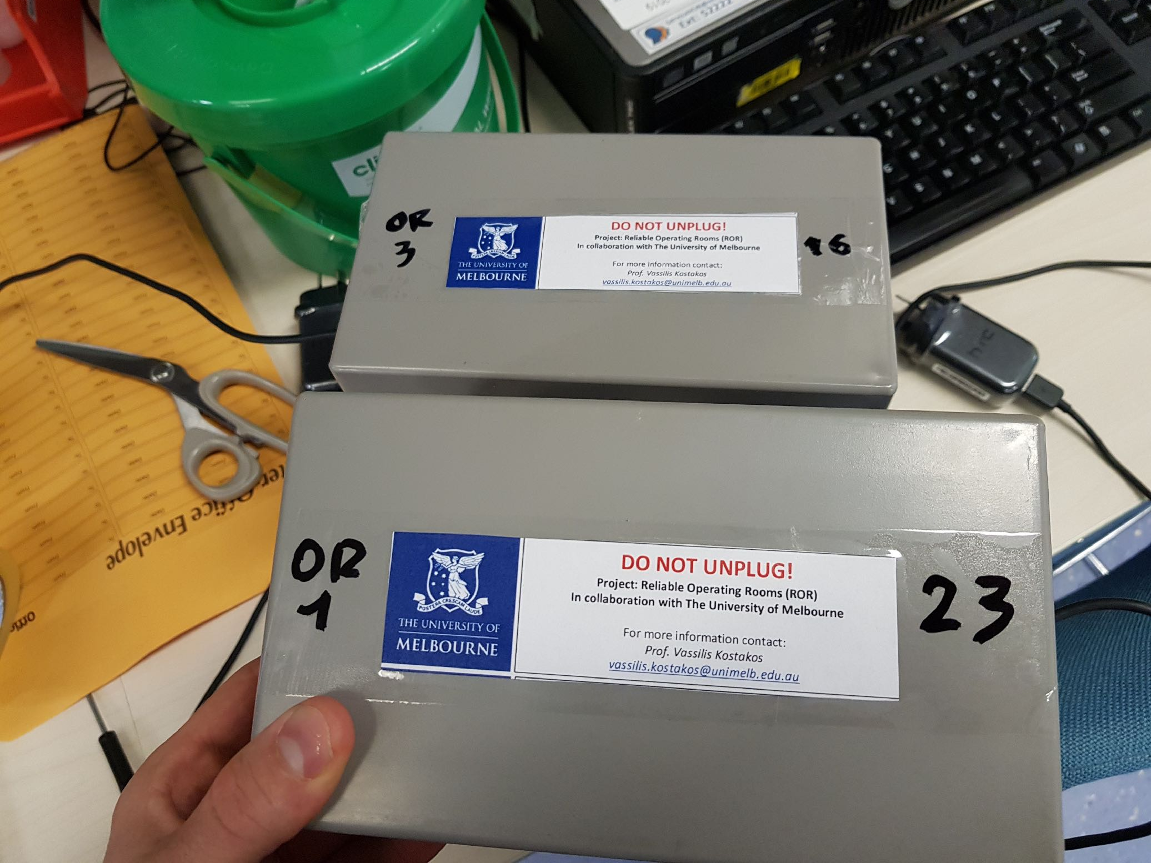

Slide 42
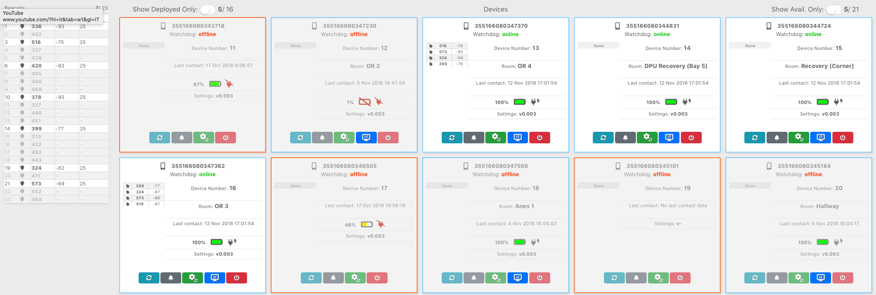

Slide 46
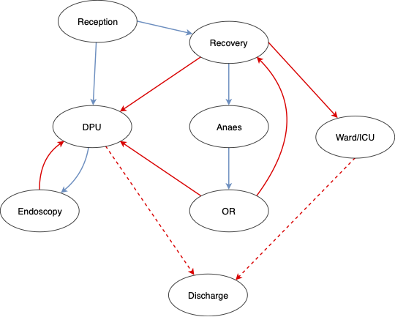

Slide 47
Summary
Characterizing location technologies
Location representation
Infrastructure and client-based location systems
Approaches to determining location
Error reporting
Location systems

